Slide 1




Student Performance Analysis Using Supervised Learning
Group: 17

Slide 2


Our Group
Bhavana Thapa (21735985)
Rishabh Chhabra (21732261)
Laxmi Bhatta (22348546)
Syed Abrar Jamil (22651396)
Abu Fatah Mohammed Faisal (23107667)

Slide 3

Introduction & Problem Statement
Domain Problem: Predicting whether a student will pass or fail their final Portuguese language course grade, enabling early intervention for at-risk students.
Translation to Data Science Problem: This is a binary classification task, where the target variable is whether the final grade (G3) is at least 10 ("Pass") or below 10 ("Fail").

Slide 4

Exploratory Data Analysis & Preprocessing
Data: 649 students, 33 variables (demographics, academics, social, grades).
Key Statistics:
Age: Median 17
Final Grade (G3): Mean 11.91, median 12
Few past failures; absences skewed (median 2).
Preprocessing:
Removed G1/G2 to prevent data leakage.
Converted character columns to factors.

Slide 5
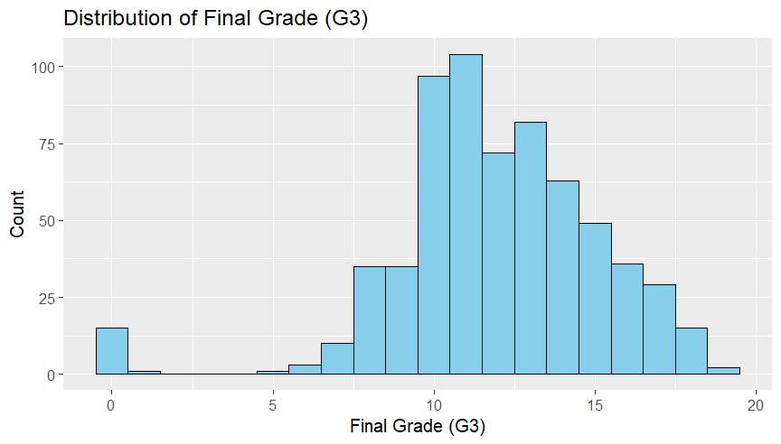
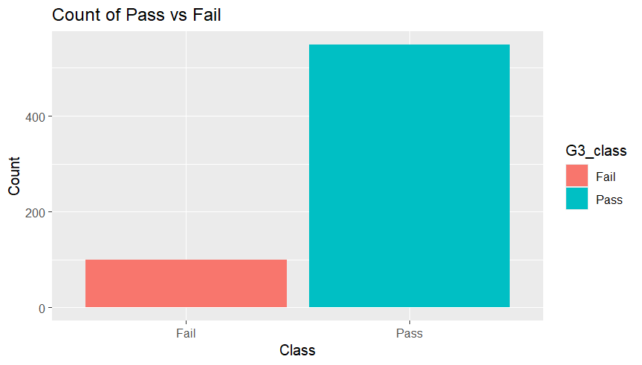
Exploratory Data Analysis & Preprocessing
Figure 1: Distribution of Final Grade (G3)
Figure 2: Count of Pass vs Fail

Slide 6
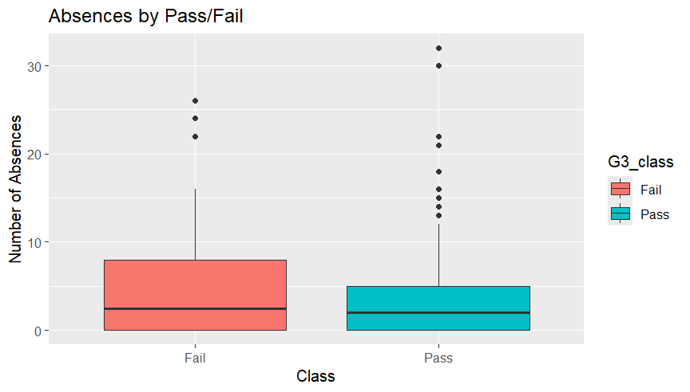
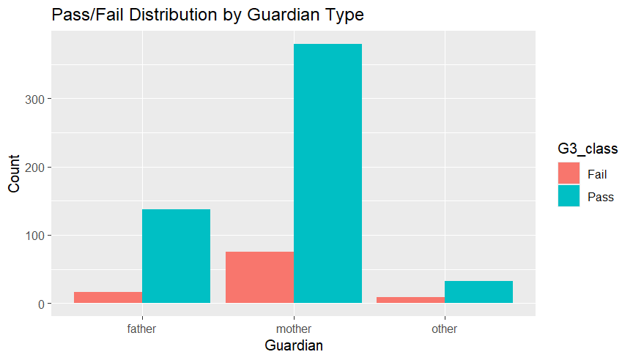
Exploratory Data Analysis & Preprocessing
Figure 3: Absences by Pass/Fail
Figure 4: Pass/Fail Distribution by Guardian Type

Slide 7

Applied Models
Model | Type | Main Features Used
Logistic Regression | Linear | failures, higher, school, absences
LASSO Logistic Regression | Regularized | Same as above, with feature selection
K-Nearest Neighbors | Non-parametric | Same features, dummy-coded and scaled
Random Forest | Ensemble | All predictors except G3
Table 1: Model Types and Key Features

Slide 8

Results
Model | Accuracy | AUC | Sensitivity | Specificity
Logistic Regression | 0.8139535 | 0.8314220 | 30% | 97%
LASSO Logistic Regression | 0.8139535 | 0.8314220 | 30% | 98%
K-Nearest Neighbors | 0.8062016 | 0.8431193 | 40% | 94%
Random Forest | 0.8372093 | 0.8192661 | 25% | 99%
Table 2: Comparison of Model Results

Slide 9

Discussion
Key predictors: absences, prior failures, school attended.
Model trade-offs:
Random Forest: highest accuracy, low sensitivity.
KNN: best at finding at-risk students, more false positives.
Limitations: class imbalance, low sensitivity, limited generalizability.
Use with teacher input for best results.

Slide 10

Conclusion
Data science approach provides actionable early intervention insights for Portuguese language courses.
Random Forest is best for overall accuracy; KNN is best for detecting at-risk students.
Future Work:
Address class imbalance.
Explore additional features (e.g., behavioural data).
Validate on new cohorts and other subjects.

Slide 11

Thank You

Slide 12
References
Baker, R. S., & Inventado, P. S. (2014). Educational data mining and learning Analytics. In Springer eBooks (pp. 61–75). https://doi.org/10.1007/978-1-4614-3305-7_4
Cortez, P., & Silva, A.M. (2008). Using data mining to predict secondary school student performance.
Kuhn, M., & Johnson, K. (2013). Applied Predictive Modeling. In Springer eBooks. https://doi.org/10.1007/978-1-4614-6849-3
Romero, C., & Ventura, S. (2020). Educational data mining and learning analytics: An updated survey. Wiley Interdisciplinary Reviews Data Mining and Knowledge Discovery, 10(3). https://doi.org/10.1002/widm.1355

